Slide 1
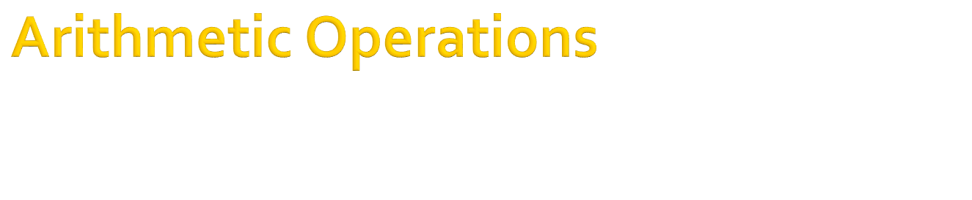
Chapter 10

Slide 2


Prolog is good in formal reasoning
But, very inefficient in numerical calculation
An example
  predicate
  go
  clauses
  go:-
  X=4+3,
  write(X),nl.
Goal:go
7
True
Goal:

Slide 3
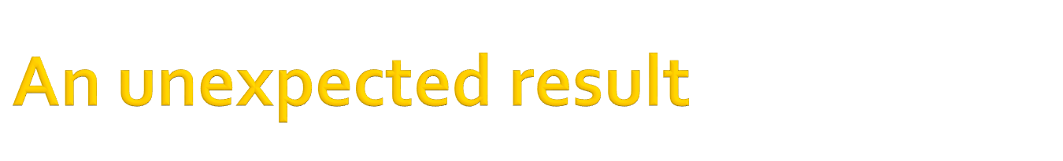

  predicate
  go
  clauses
  go:-
  X=4+3,
  write(X),nl,
  X=4-3,
  write(X),nl.
Goal:go
7
False
Goal:

Slide 4
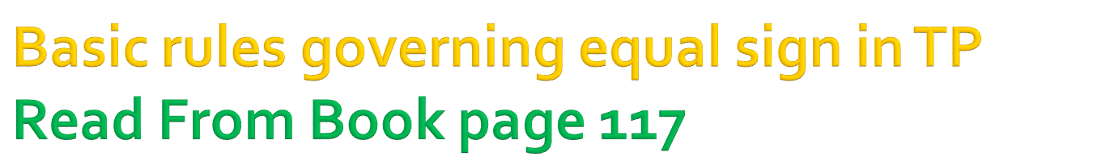
Free_var= object
  the free variable will be bound to the object value and goal will succeed
  X=4+3
Bound_var=Object
  goal will succeed if the variable is already bound to the value of the object
  X=7, X=5+2
Free_var=Bound_var
  free variable will be bound to the value of the bound variable and goal will succeed
  Y=7, X=Y

Slide 5

Bound_var1=Bound_var2
  goal will succeed if and only if both have the same value.
  X=7, Y=5+2, X=Y will be true
object1=object2
  goal will succeed if and only if they are same.
  apple=apple
Note: free_var=free_var will cause warning message

Slide 6
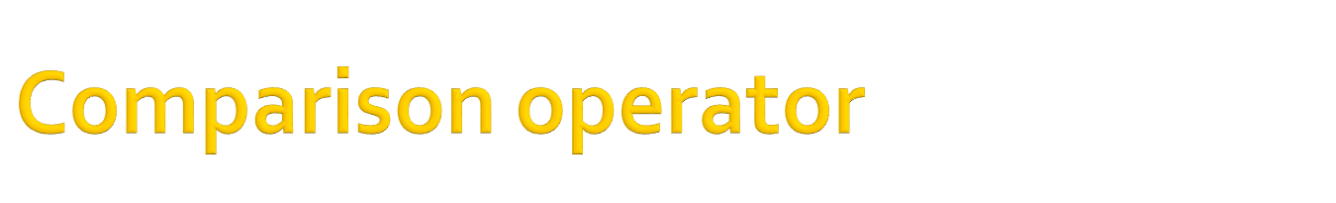

predicate
go
clauses
go:-
X<=4+3,
write(X),nl
Will never compile
predicate
go
clauses
go:-
X=2,
X<=4+3,
write(X),nl
Goal:go
2
true
Goal:

Slide 7
Symbol | Meaning
< | Less than
> | Greater than
= | equal to
<= | Less than or equal to
>= | Greater than or equal to
<> | not equal to

Slide 8


Please see page 122-123 for
the list of mathematical functions and their usage

Slide 9
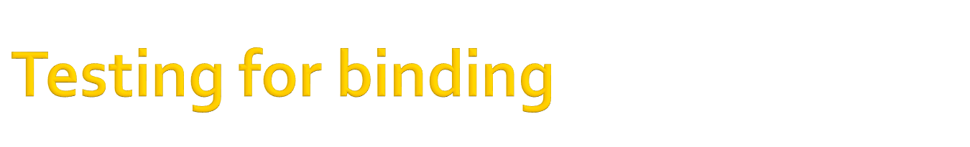
free(X)
  the built-in predicate free(X) succeeds if the argument is free.
bound(X)
  succeeds if the argument is a bound variable.
add(X,Y,Sum):-
Sum=X+Y.
add(X,Y,Sum):-
free(Sum),
Sum=X+Y.

Slide 10
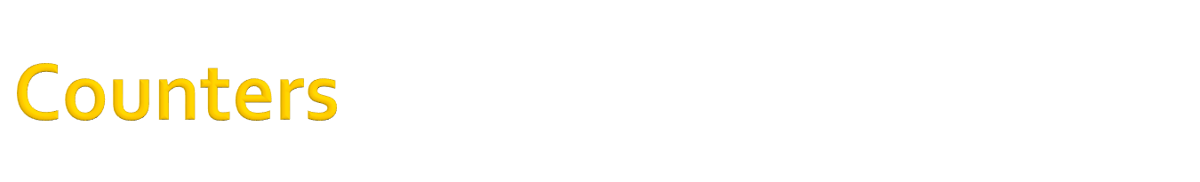
X=X+1
  will not work
  why ????
predicate
count(int)
clauses
count(9).
count(X):-
Y=X+1,
count(Y).

Slide 11
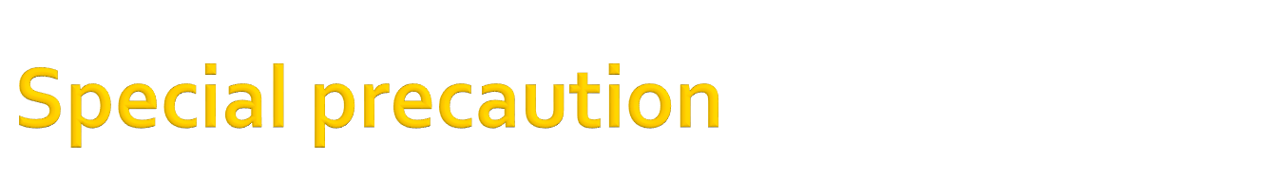
go:-
N=20,
write_space(80-N).
write_space(0):-
!.
write_space(X):-
write(“ “),
NN=N-1,
write_space(NN).
go:-
N=20,
write_right_space(N).
write_right_space(0):-
Y=80-N,
write_space(N).
write_space(0):-
!.
write_space(X):-
write(“ “),
NN=N-1,
write_space(NN).

Slide 12
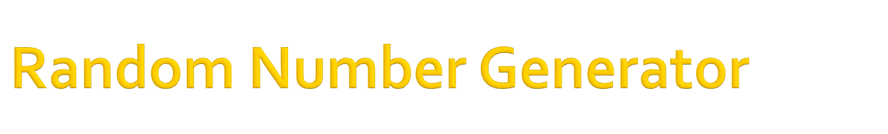

rand(X,Y):-
random(Z),
Y=(X-1)*Z+1
rand(X,Y):
X must be bound.
the function generates a random number (Y)
between 1 to X

Slide 13

Write a predicate to return the minimum value of X and Y.
Write a prolog program to compute the sum of the series 1+2+…..+N
Write a prolog program to compute the sum of N random numbers ranging from 1 to 100.

Slide 14
End of Slide

